Slide 1


David Hoff david.hoff@umb.edu – 617-480-9230
Institute for Community Inclusion
University of Massachusetts, Boston www.communityinclusion.org
Employer Engagement
During Challenging Times
Part 1

Slide 2

Webinar Logistics
Please mute if not speaking
Post questions and comments in the chat
Raise your hand in the participant area to ask questions and share comments verbally
Webinar is being recorded
Closed captioning can be activated
via closed captioning button on screen

Slide 3
Handout
Employer Engagement Publication

Slide 4
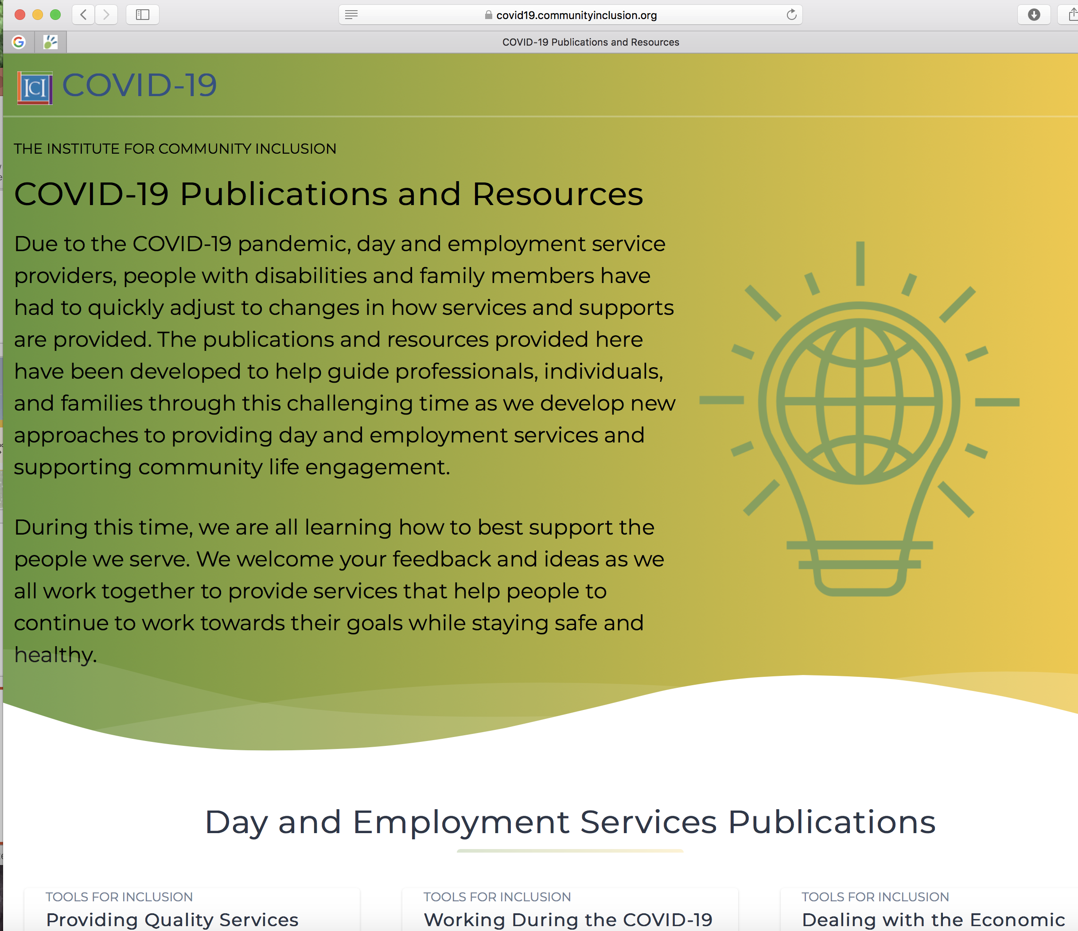
ICI COVID-19 Resource Page https://covid19.communityinclusion.org
24 publications
Resource listings

Slide 5
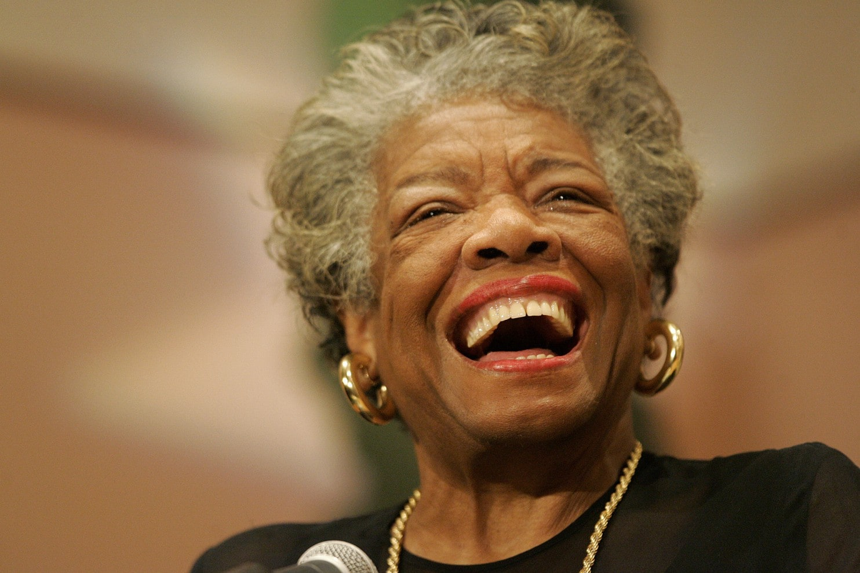
“If you’re always trying to be normal, you’ll never know how amazing you’ll be.”
Maya Angelou

Slide 6

Two Questions
Hiring trends
Types of jobs

Slide 7


Increased unemployment
Inability to meet with employers
in person

Slide 8

We Need to Stick to Our Values
People with disabilities
can and must compete for available job openings!

Slide 9
It’s not about doing things differently.
It’s about doing things better.

Slide 10

The Starting Point
Maximize
Best Practices

Slide 11

Networking

Slide 12


More Networking
Less Cold Calling

Slide 13


What Job Development Is Not
Filling out job applications
Searching for jobs on the internet
This Photo by Unknown Author is licensed under CC BY-SA

Slide 14

Networking is not just about identifying contacts.
It’s about knowing how to engage contacts.

Slide 15

Person-Centered Planning for
Strong Job Matches

Slide 16

Prepared candidates who present well to prospective employers

Slide 17


Some suggested strategies…

Slide 18

Systematic analysis of employer needs

Slide 19

Make the case & negotiate…

Slide 20

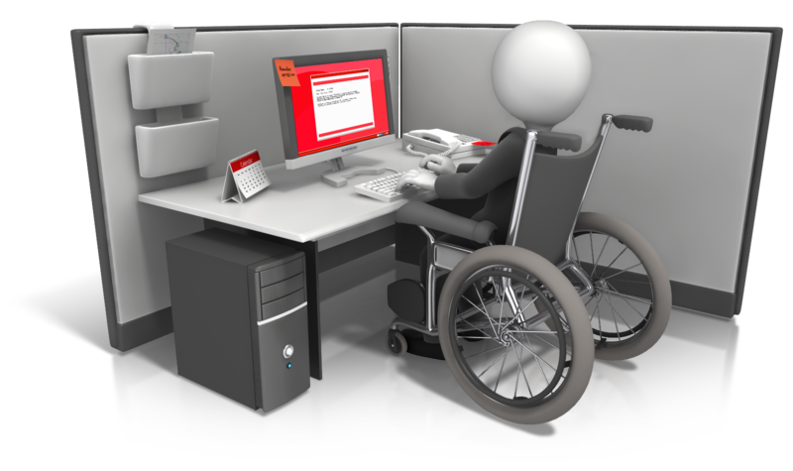
# 6
Accommodations

Slide 21



Accommodation & Assistive Technology Resources
askjan.org
National Assistive Technology Act Technical Assistance & Training Center
at3center.net
massmatch.org

Slide 22

Use Social Media Effectively

Slide 23

Understand the Job Market

Slide 24


Quality Post Placement Supports
This Photo by Unknown Author is licensed under CC BY
This Photo by Unknown Author is licensed under CC BY

Slide 25




Slide 26


Slide 27


David Hoff
david.hoff@umb.edu – 617-480-9230

